Slide 1
TERM PROJECT
MEMBERS: NIDHI SHETTY (nidhi.shetty@su.suffolk.edu)
EASHAN SINGHAL(eashan.singhal@su.suffolk.edu
AAYUSH RAWLANI (aayushrajkumar.rawlani@su.suffolk.edu)
RAJKUMARI CHOUHAN( Rajkumari.chouhan@su.suffolk.edu)

Slide 2
DATASET-SUPERMARKET SALES
Supermarkets are expanding in most populated cities, and market competition is fierce. The dataset is one of the historical sales of a supermarket company that was recorded in three different branches over a three-month period. With this dataset, predictive data analytics methods are simple to apply.
Variables:
Invoice id: Computer generated sales slip invoice identification number
Branch: Branch of supercentres (3 branches are available identified by A, B and C).
City: Location of supercentres
Customer type: Type of customers, recorded by Members for customers using member card and Normal for without member card.
Time: Purchase time (10am to 9pm)
Payment: Payment used by customer for purchase (3 methods are available – Cash, Credit card and E-wallet)

Slide 3
CONTINUATION
Gender: Gender type of customer
Product line: General item categorization groups - Electronic accessories, Fashion accessories, Food and beverages, Health and beauty, Home and lifestyle, Sports and travel
Unit price: Price of each product in $
Quantity: Number of products purchased by customer
Tax: 5% tax fee for customer buying
Total: Total price including tax
Date: Date of purchase (Record available from January 2019 to March 2019)
COGS: Cost of goods sold
Gross margin percentage: Gross margin percentage
Gross income: Gross income
Rating: Customer stratification rating on their overall shopping experience (On a scale of 1 to 10)

Slide 4
VARIABLE TYPES
INVOICE ID | numeric
BRANCH | String and nominal
CITY | String and nominal
CUSTOMER TYPE | String and nominal
TIME | date\time
PAYMENT | String and nominal
GENDER | String and nominal
PRODUCT LINE | String and nominal
UNIT PRICE | numeric
QUANTITY | numeric
TAX | numeric
TOTAL | numeric
DATE | date\time
COGS | numeric
GROSS MARGIN PERCENTAGE | numeric
GROSS INCOME | numeric
RATING | numeric

Slide 5
Predictive Analytics Questions.
How total amount is affected by gross margin?
TARGET
PREDICTOR
GROSS MARGIN
TOTAL

Slide 6
QUESTIONS
How is COG (Cost of Goods) affected by Product Line, Gender and Customer Type?
TARGET
COG
PREDICTOR
GENDER, PL and CUSTOMER TYPE.

Slide 7
QUESTIONS
How is COG affected by Unit Price and Margin?
TARGET
COG
PREDICTOR
UNIT PRICE, GROSS MARGIN

Slide 8
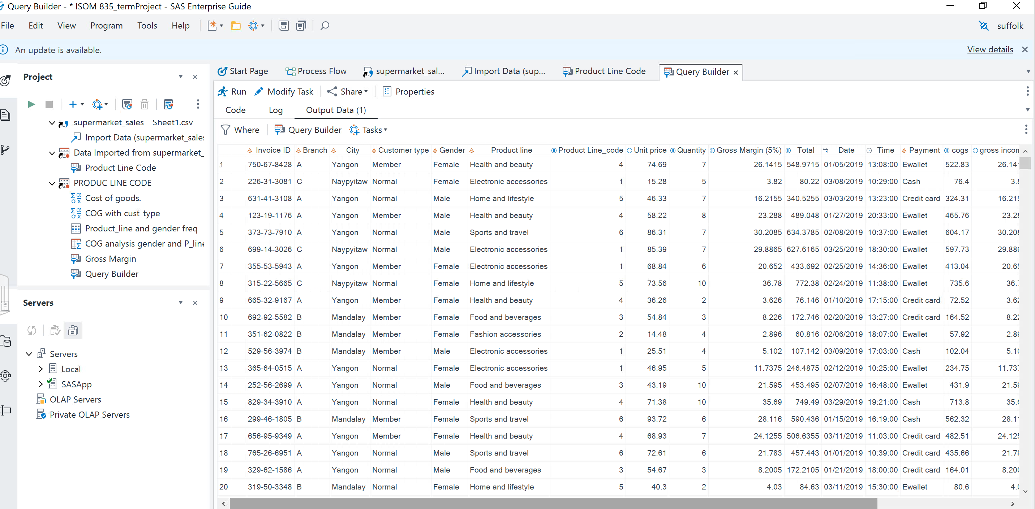
DATASET
The Product Line had 6 Unique Values so we decided to change them to Numerical Values by using Recoded Computed Columns Method so that it could help to Perform the Analysis better.

Slide 9
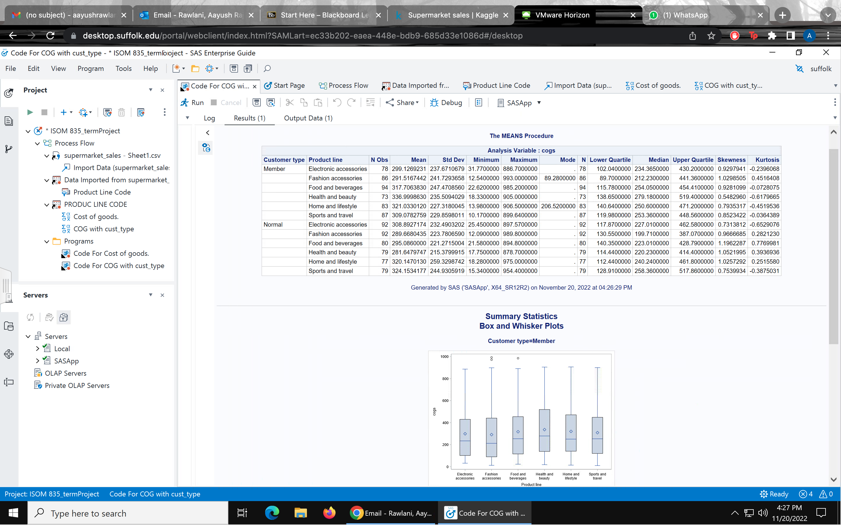
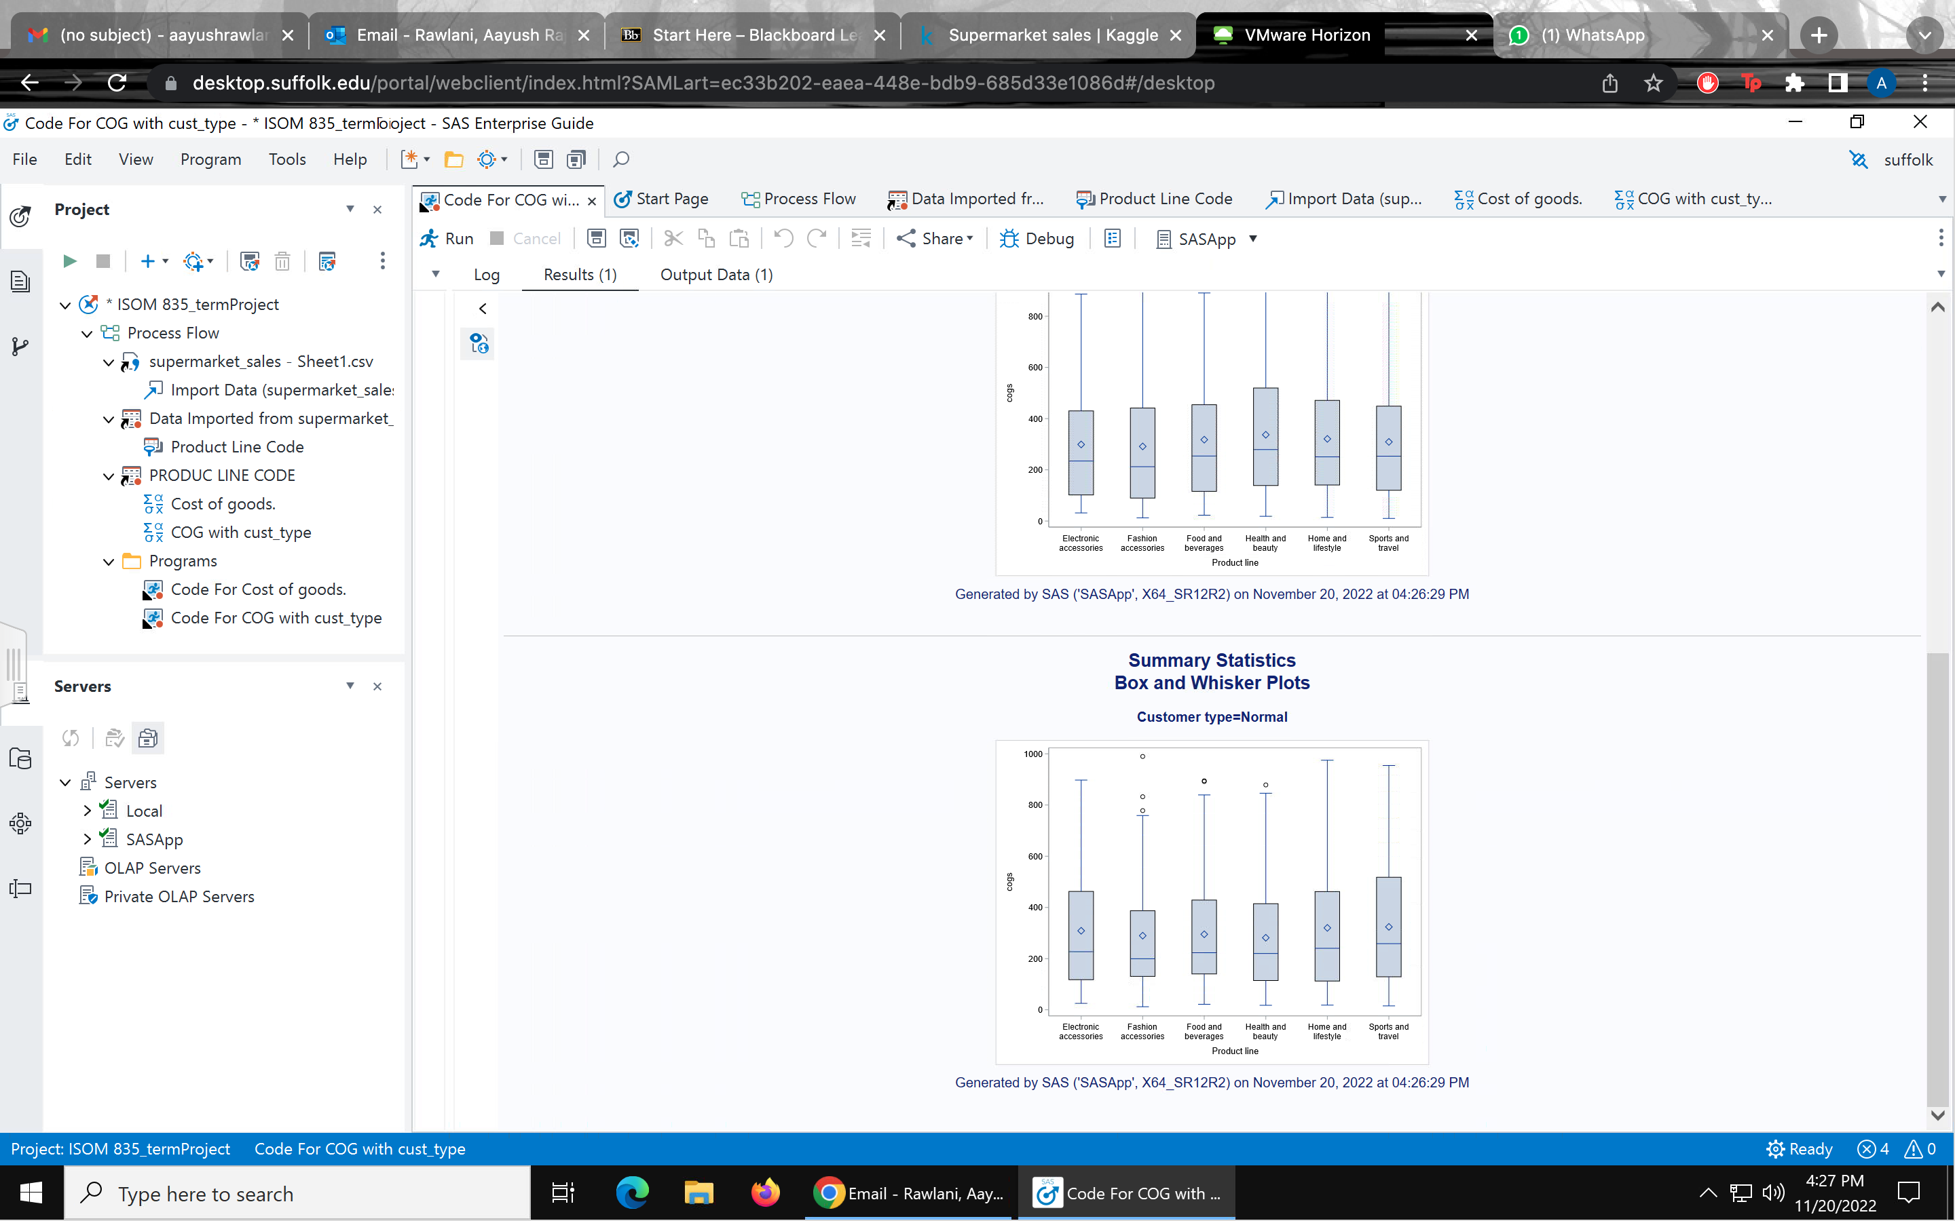
SUMMARY STATISTICS
Ran a summary statistics with cost of goods sold as an analysis variable and customer type and product line as categorical variables.
We found that there are no missing values in the dataset
We also added skewness and kurtosis to measure how balanced the data was and found that there are no significant skewness values in the data.
We also identified 3 outliers in the female and male box plot

Slide 10
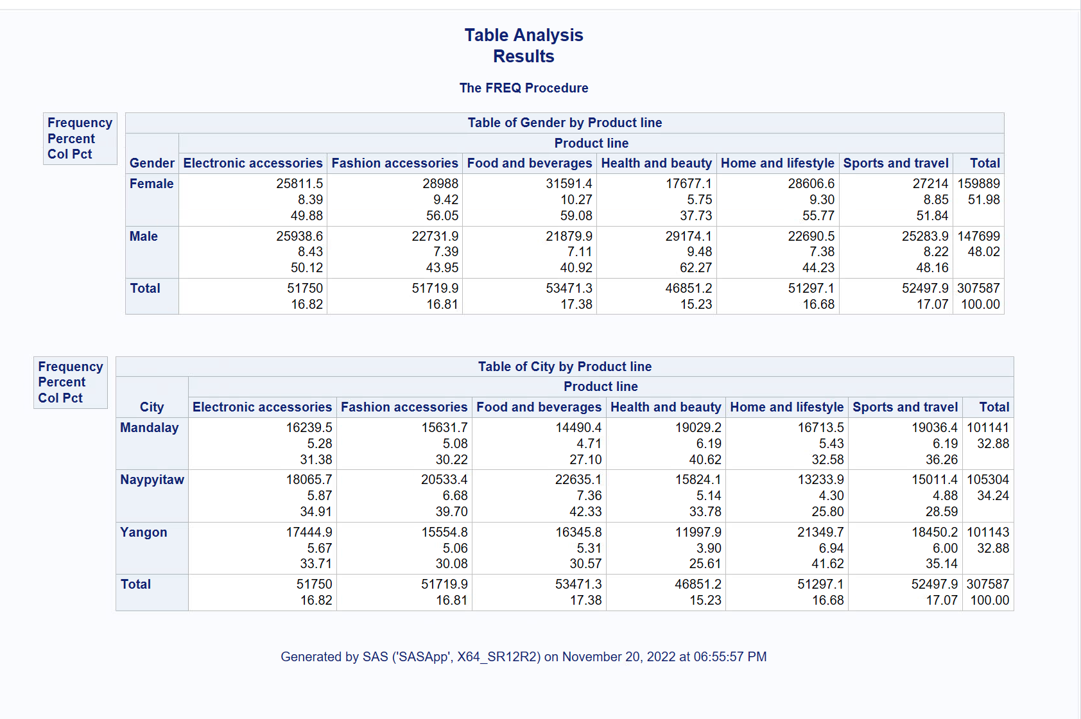
TABLE ANALYSIS
Table analysis between gender and product line, to compute the functional dependencies between the two variables
Between gender and product line:
Highest percentage of health and beauty – 62% men as compared to 37% females
Females have had the highest percentage of 59% in the food and beverages category.
Between city and product line:
Yangon had the highest spending in the home and lifestyle category being 41.62%

Slide 11
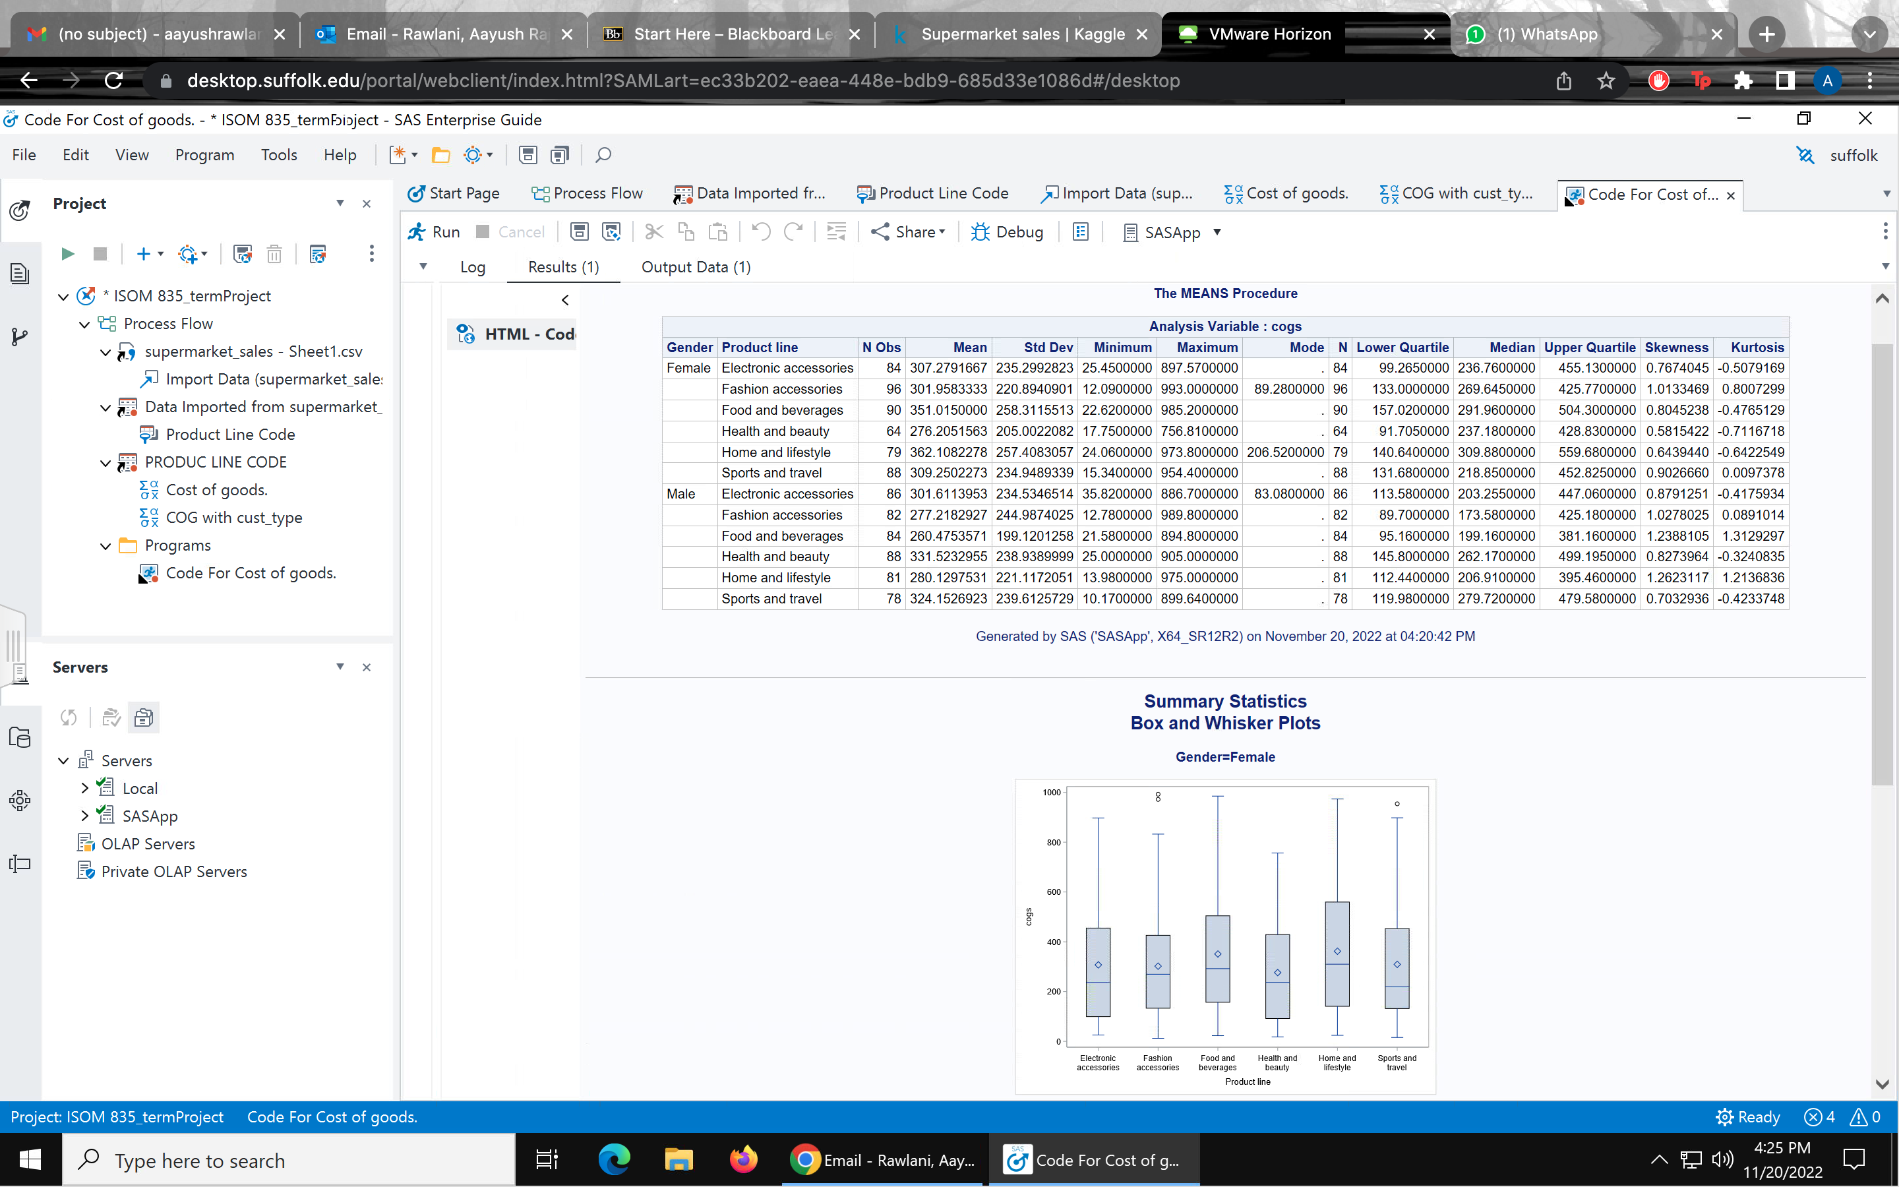
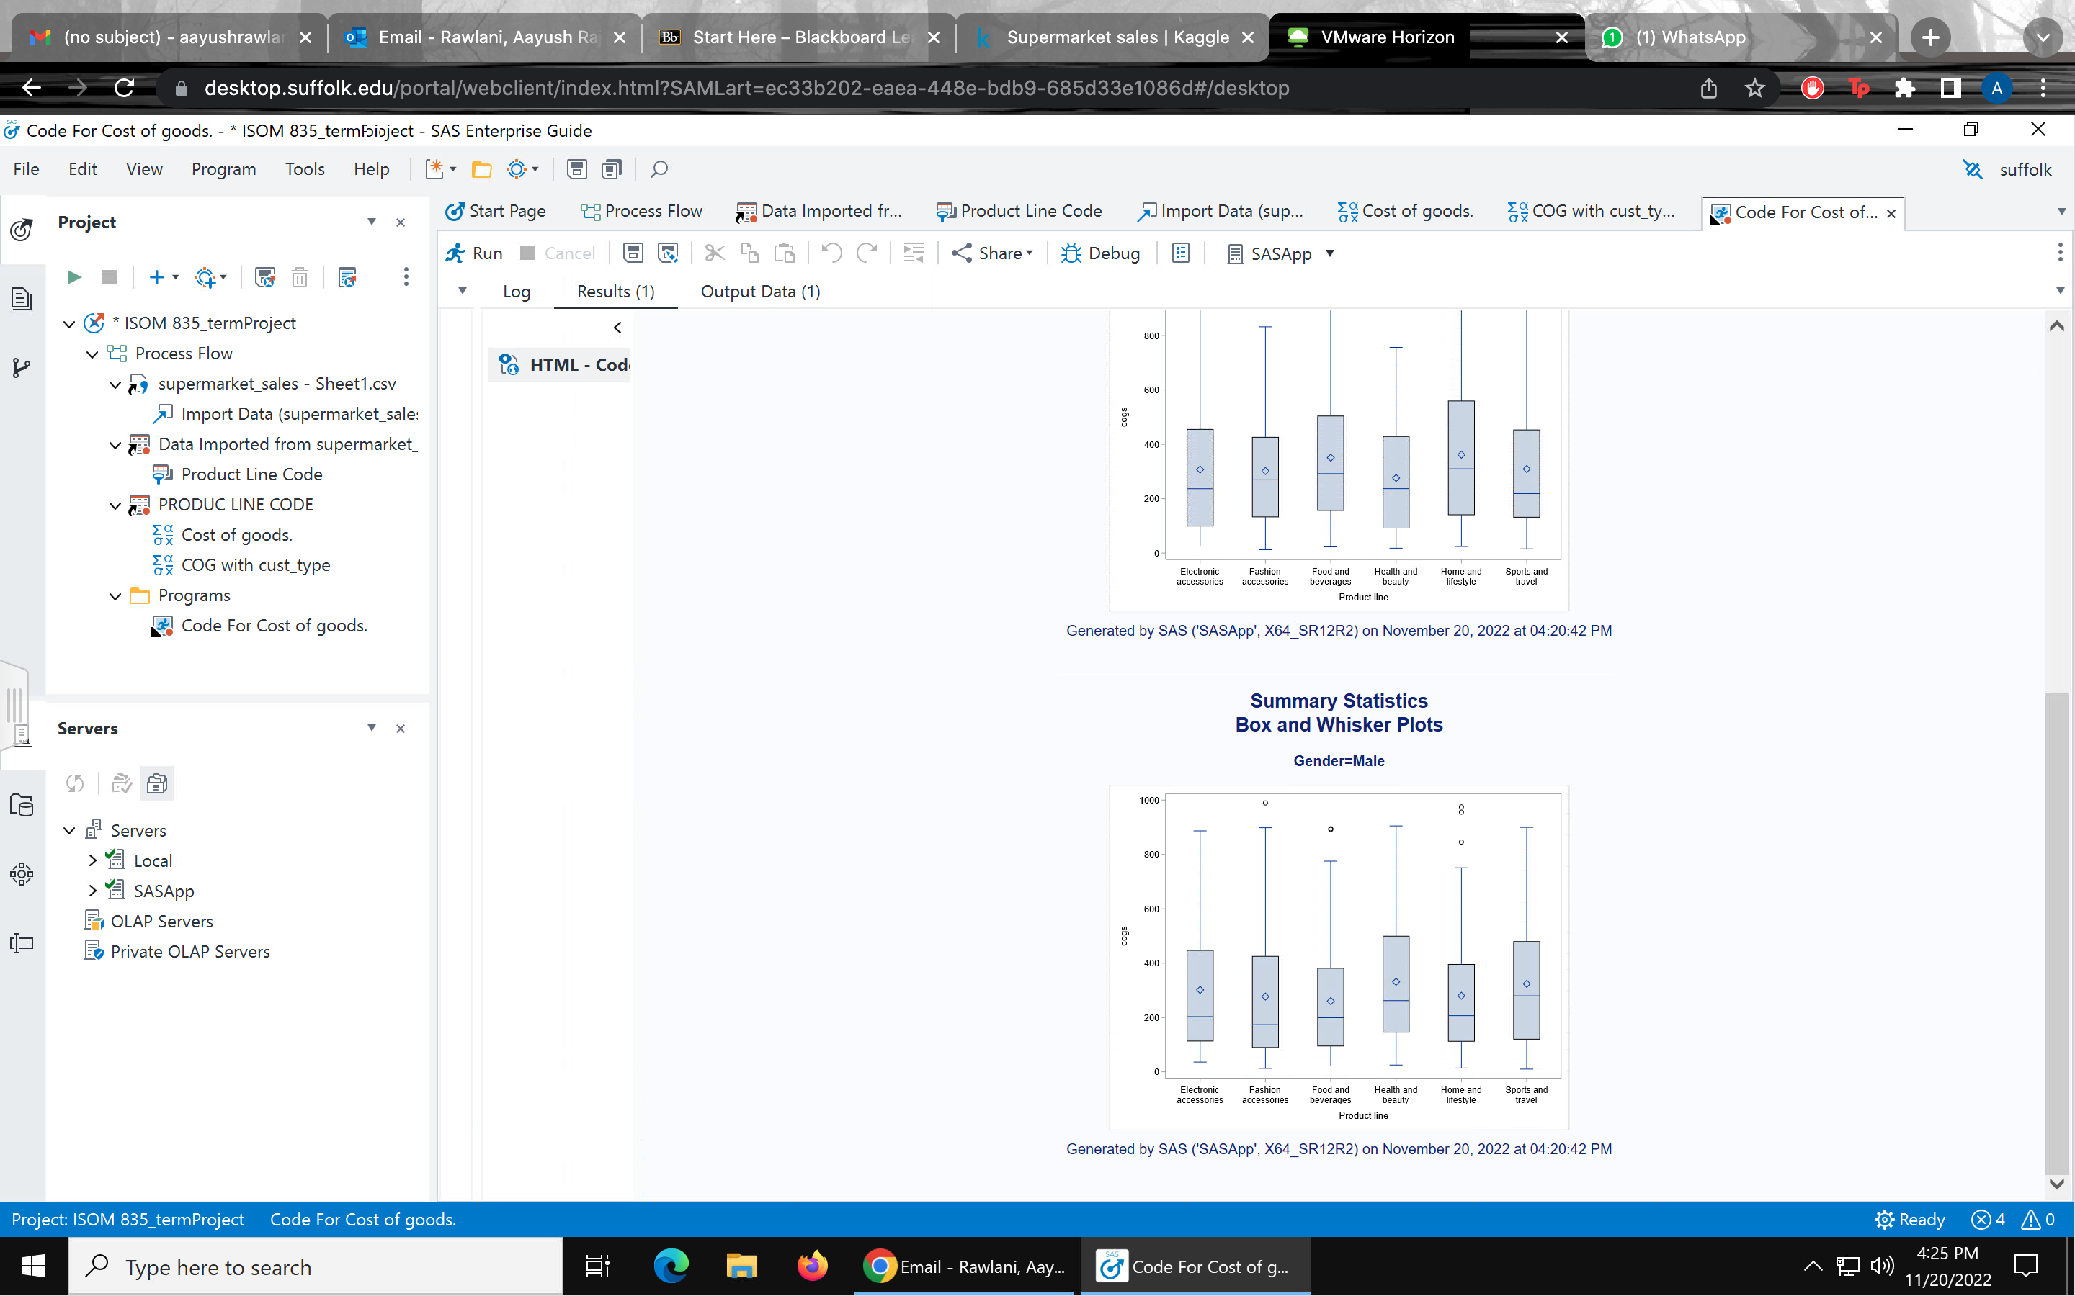
SUMMARY STATISTICS
Ran a summary statistics with cost of goods sold as an analysis variable and gender and product line as categorical variables.
We found that there are no missing values in the dataset
We also added skewness and kurtosis to measure how balanced the data was. Eg – The skewness between females & health and beauty was 0.58 which is not very significant.
We also identified 3 outliers in the female and male box plot

Slide 12
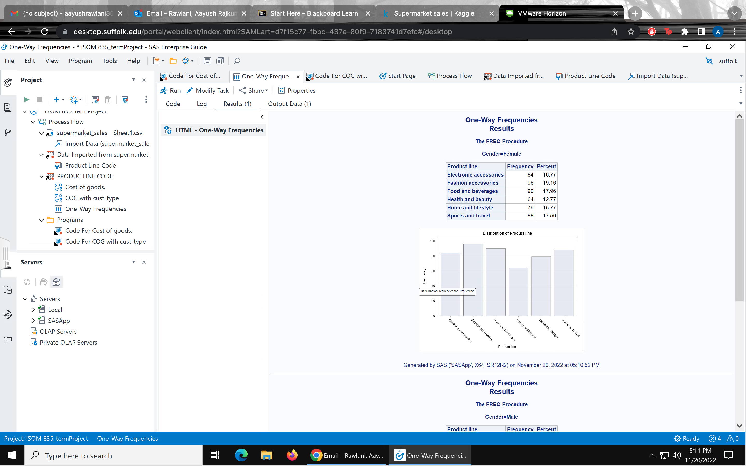
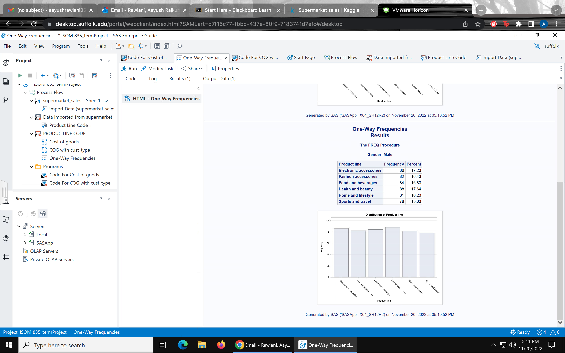
DATA UNDERSTANDING/PREPARATION.
Ran a one-way frequency table between product line and gender to find the frequency count and percentages and analysed the distribution of our data.
We found that the frequency both genders are evenly distributed between all the product line categories.

Slide 13
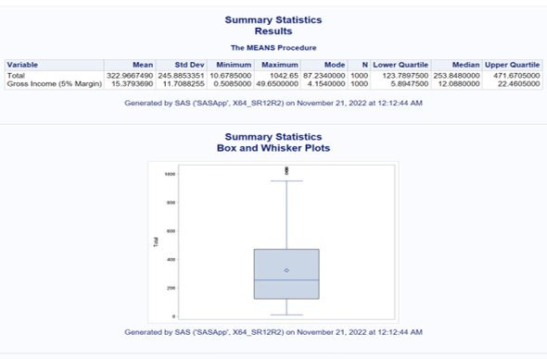
SUMMARY STATISTICS.

Slide 14
APPENDIX
Super Market Sales URL: https://www.kaggle.com/datasets/aungpyaeap/supermarket-sales

